Slide 1
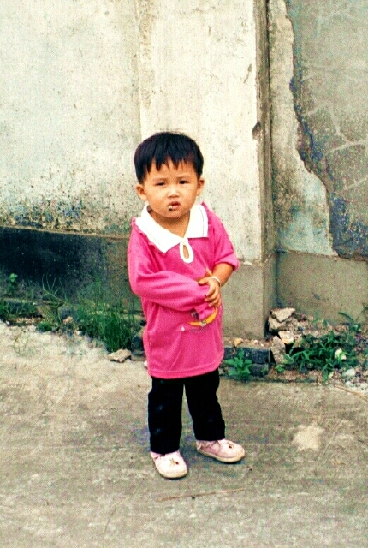
Chapter 5
Human Development

Slide 2
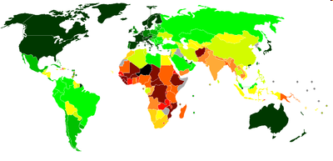
Human Development Index (UNDP)
Geometric mean of 3 indices:
  Life expectancy
  Education
  GDP (log transformation; diminishes returns to income as means of attaining a decent standard of living)
    i.e., diminishing utility from income
Lowest: Black-Red
Highest: Dark Green

Slide 3
Why the Ln of Income?
P/cap Incomes ranged from $260 (Liberia) to $93,383 (Qatar)
  That’s really big
Would an increase in income in rich countries affect human development as much as the same increase in poor countries? (No)
The natural compresses the income range
  Ln(260) = 5.56 (Liberia) and Ln(93,383) = 11.44 (Qatar).

Slide 4
An Index of Indexes
Education Index:
HDI:
EYSC: Expected Years of School Completion
MYSA: Mean Years of School Attainment
E: Education
GNI: (Ln) of Gross Domestic Income
LE: Life Expectancy

Slide 5
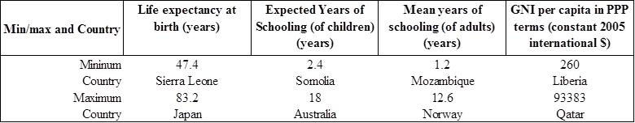
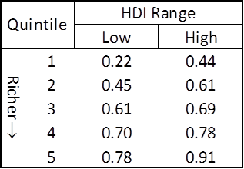
Human Development

Slide 6
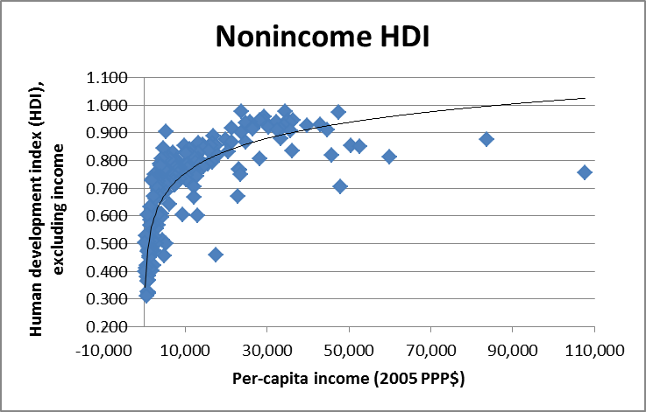
HDI and Income

Slide 7
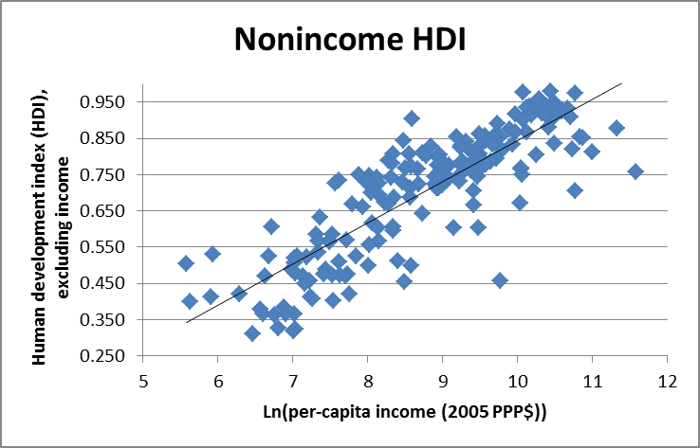
HDI and (Ln) Income

Slide 8
Why the Variation?
Non-economic factors?
  E.g., Swaziland and Ukraine have similar levels of per-capita GDP ($4,300, PPP)
  But HIV/AIDS lowered life expectancy to 38 years in Swaziland (vs. 69 yrs in Ukraine)
Education and other policies?
  Algeria and Panama ~$6,000
  But 92% of Panamanians are literate vs. 68% of Algerians
Inequality? According to the World Bank:
  Panama: Gini = 51.9
  Algeria: Gini = 35.3

Slide 9
The Best and the Worst at Turning Income into Human Development

